Slide 1

MULTIPLE DISEASE PREDICTION APPLICATION
.

Slide 2
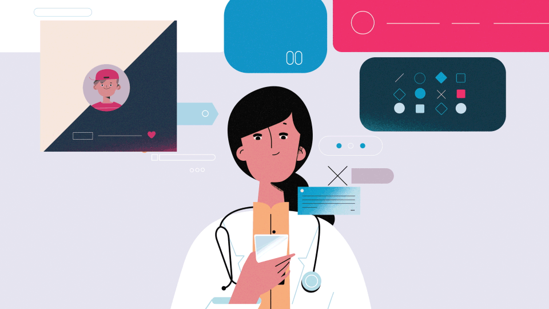
ABSTRACT
This project can help a lot of people as one can monitor the persons’ condition and take the necessary precautions thus increasing the life expectancy.
To implement multiple disease analysis used machine learning algorithms, Streamlit and python pickling is utilized to save the model behavior.
We have considered six diseases for now that are jaundice disease, hepatitis, Heart, Liver, Parkinson’s disease and Diabetes and in the future, many more diseases can be added.

Slide 3
MISSION
VISION
To help out the poor and helpless people with the normal medical checkup
To extend the role of the technology in the medical field

Slide 4

INTRODUCTION
Machine Learning is the domain that uses past data for predicting. Machine Learning is the understanding of computer system under which the Machine Learning model learn from data and experience.
Now day’s heart diseases are growing rapidly by busy and stress full life. All type of age groups is under diseases so need of early detection of disease by using symptoms or reports
We are applying complete machine learning concepts to keep the track of patient’s health. ML model allows us to build models to get quickly cleaned and processed data and deliver results faster.

Slide 5

Any disease that we can take precaution is preventable.

Slide 6
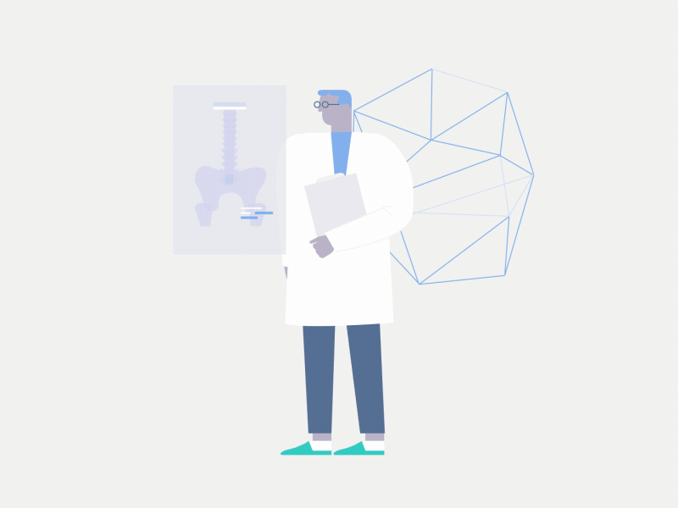
PROBLEM SYSTEM
Many of the existing machine learning models for health care analysis are concentrating on one disease per analysis. For example, first is for liver analysis, one for cancer analysis, one for lung diseases like that.
If a user wants to predict more than one disease, he/she has to go through different sites. There is no common system where one analysis can perform more than one disease prediction.

Slide 7

PROPOSED SYSTEM
In multiple disease prediction, it is possible to predict more than one disease at a time. So, the user doesn’t need to traverse different sites in order to predict the diseases. We are taking three diseases that are Liver, Diabetes, and Heart. As all the three diseases are correlated to each other. To implement multiple disease analyses we are going to use machine learning algorithms and Django. When the user is accessing this API, the user has to send the parameters of the disease along with the disease name. Django will invoke the corresponding model and returns the status of the patient.

Slide 8
SYSTEM ANALYSIS
Functional Requirement
Non-Functional Requirement
The system allows the patient to predict the disease
The website will provide range of the values during the prediction of the disease.
The user adds the input for the particular disease and based on the trained model of the user input the output will be displayed .
The website should be reliable and consistent

Slide 9
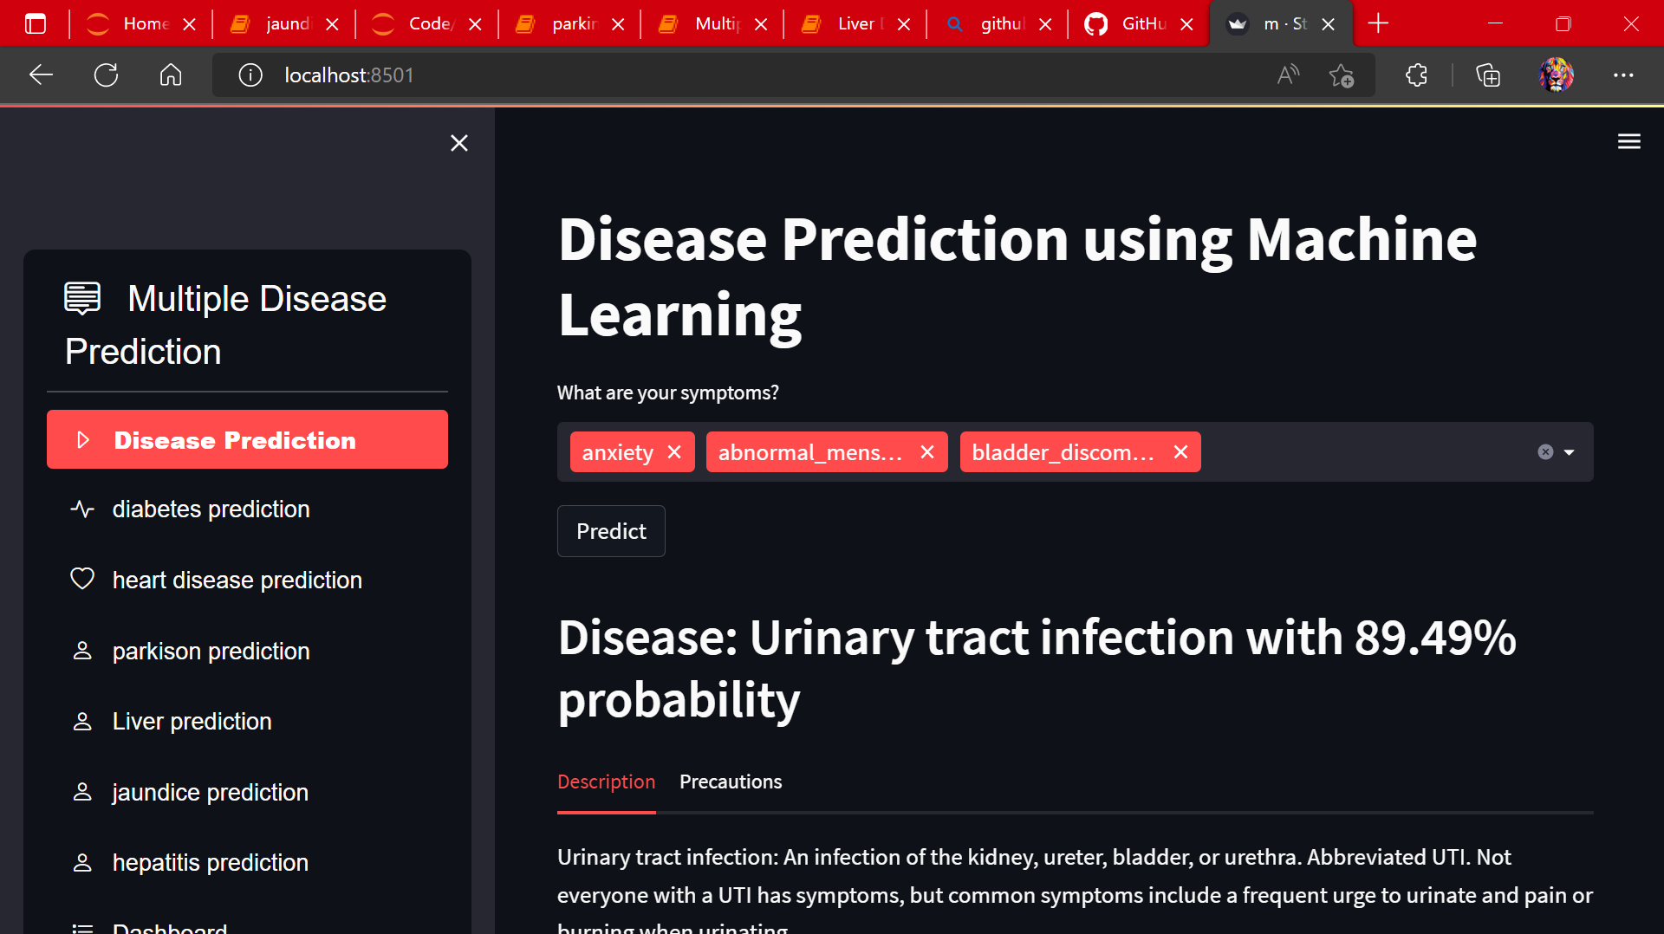
Disease Prediction Based on Symptoms Using Machine Learning

Slide 10
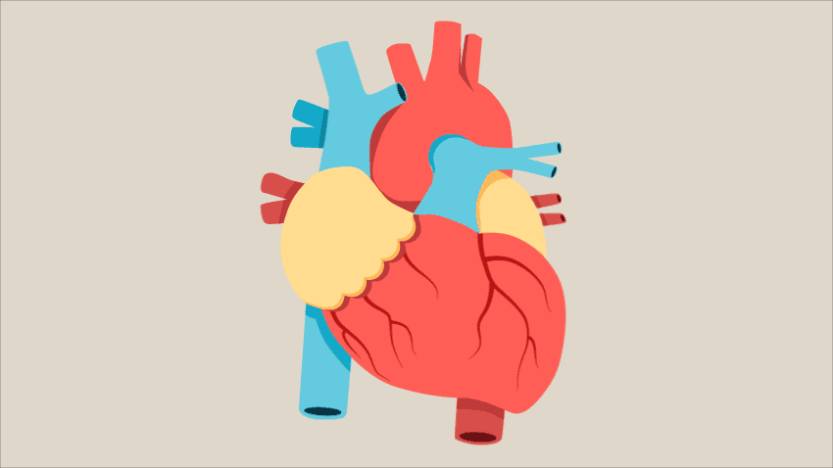
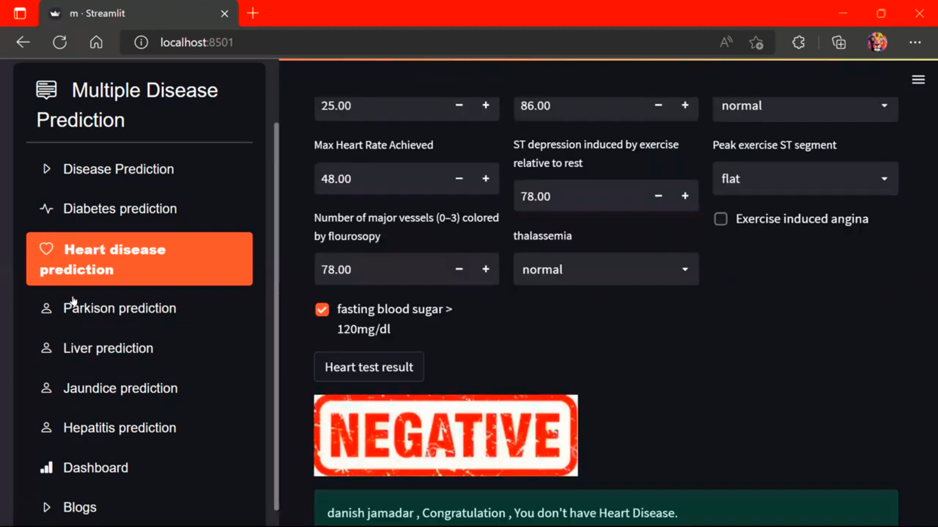
HEART FAILURE PREDICTION

Slide 11
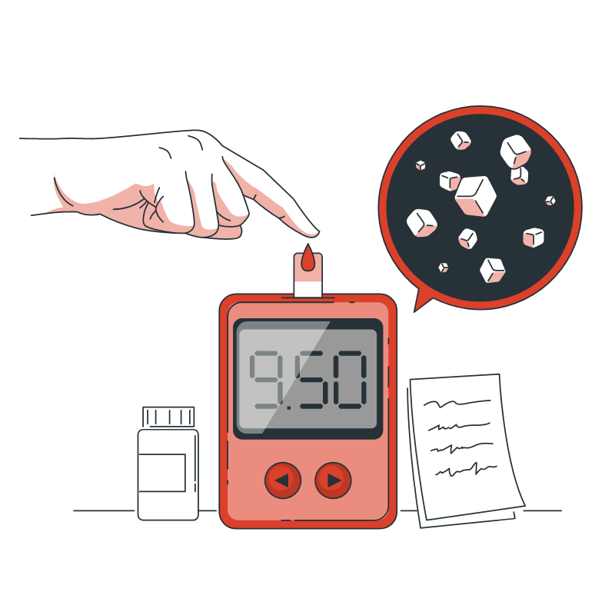
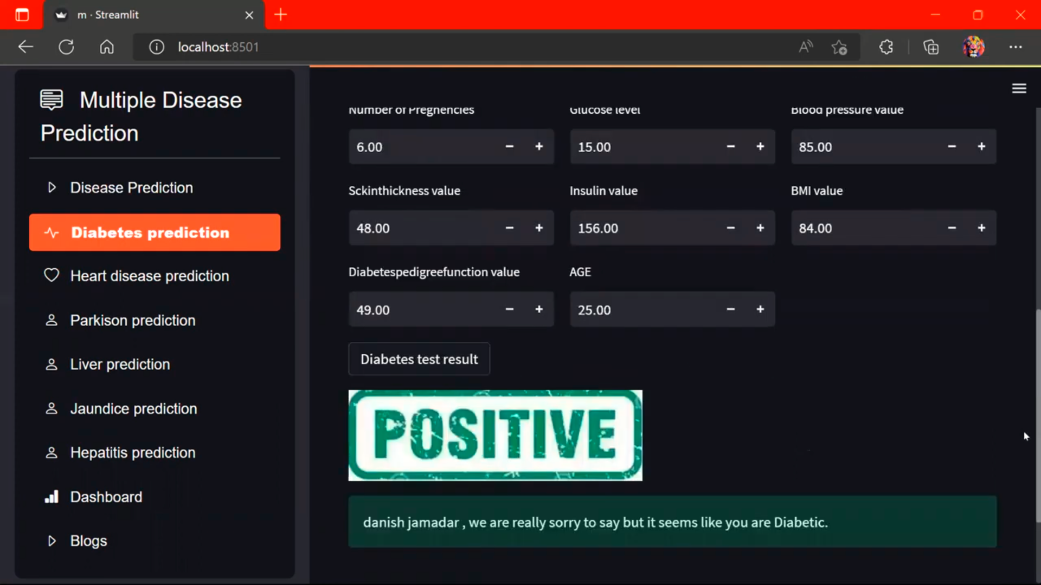
DIABETES PREDICTION

Slide 12

PROJECT REQUIREMENTS
Software USED : Python interpreter , jupyter notebook, Vs code , Any browser
Front-end USED : streamlit python library
Back-end USED : Python , NumPy ,Pandas, and
Scikit-Learn,
Database USED : sqlite3

Slide 13

FUTURE SCOPE
In the future we can add more diseases in the existing API.
We can try to improve the accuracy of prediction in order to decrease the mortality rate
Try to make the system user-friendly and provide a chatbot for normal queries

Slide 14



